Slide 1
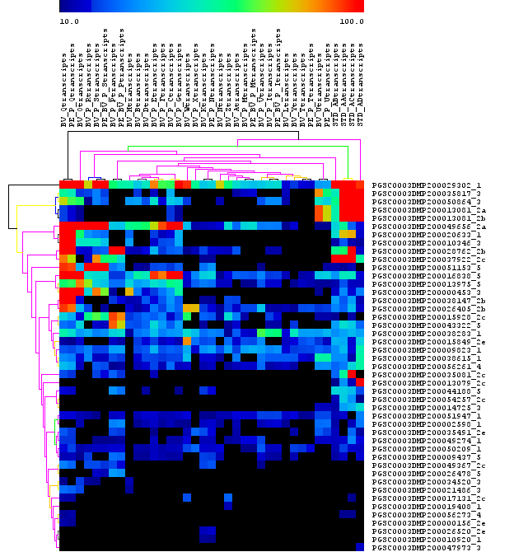
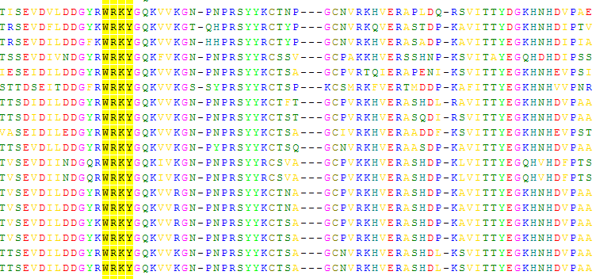
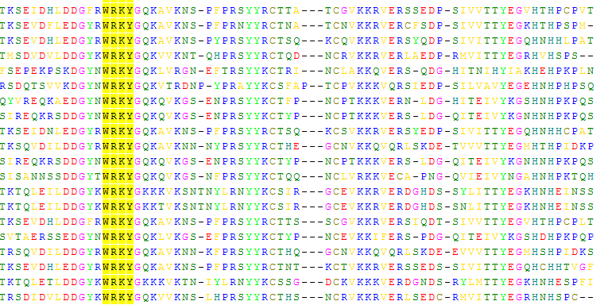
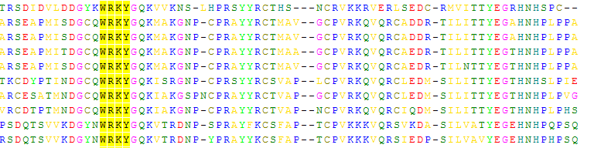
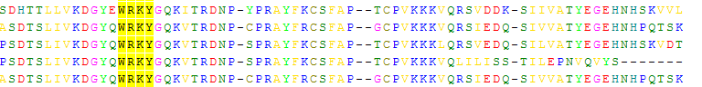
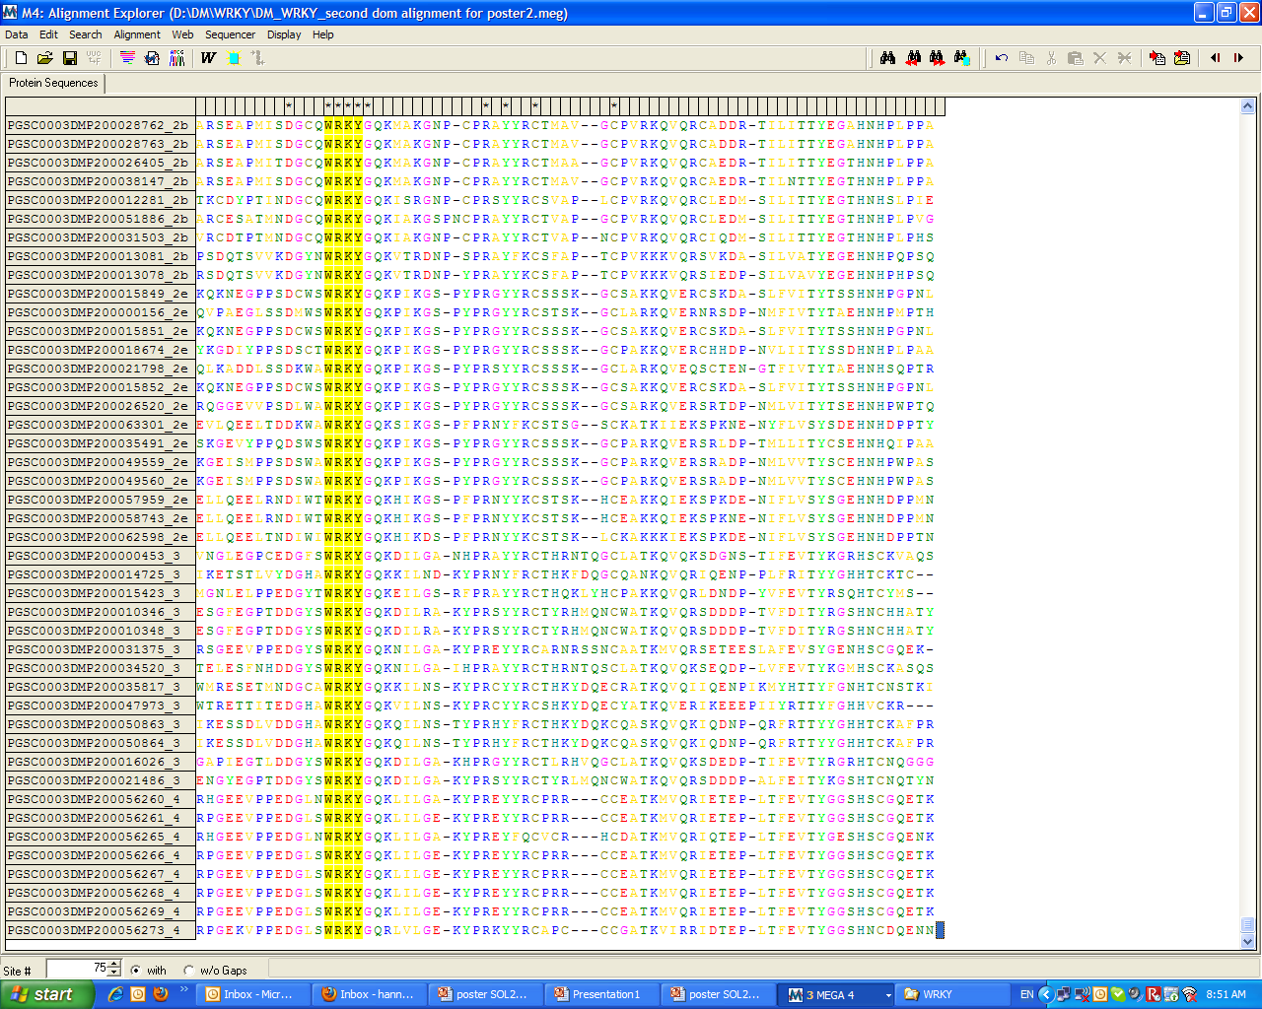

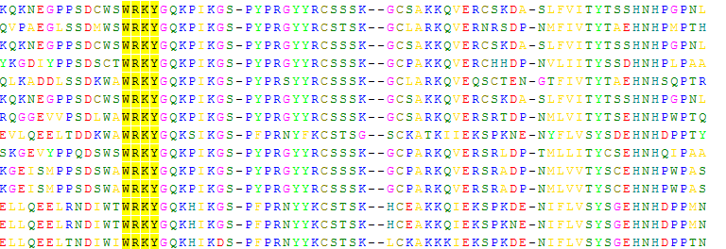



Julián Mateus¹ • Stef de Haan² Carlos Chuquillanqui²
Ian Barker² • Alfredo Rodríguez ³
¹ Corporación Colombiana de Investigación Agropecuaria (CORPOICA). Centro de Investigación Tibaitatá. • Km 14 vía Bogotá – Mosquera. Colombia
² International Potato Center (CIP). Germplasm Enhancement and Crop Improvement-Crop Management Division • Av. La Molina 1895. La Molina. Lima 12. Perú
³ Universidad Nacional Agraria La Molina. Centro de Investigación de Hidroponía y Nutrición Mineral Departamento de Biología. • Av. La Molina s/n. La Molina. Lima 12. Perú
Respuesta de tres variedades de papa en un sistema Aeropónico novedoso para la producción
Background
WRKY proteins are a superfamily of transcription factors involved in various physiologial processes in plants, including pathogen defence. WRKY transciption factors have been shown to act as both negative and positive regulators of defence, suggesting that they may operate through different regulatory complexes. The different roles can be partly determined by the topological features of the proteins.
The WRKY domain is defined by the conserved amino acid sequence WRKYGQK at the N-terminal end followed by a zinc-finger-like motif. WRKY proteins are classified based on the number of WRKY domains and the structure of the zinc-finger-like motif.
The data presented here is the first step towards unveiling the role of WRKY transcription factors in regulating pathogen defence responses in CIP’s potato germplasm.
The evolutionary history was inferred using the Neighbor-Joining method [2]. The bootstrap consensus tree inferred from 1000 replicates [3] is taken to represent the evolutionary history of the taxa analyzed [3]. Branches corresponding to partitions reproduced in less than 50% bootstrap replicates are collapsed. The percentage of replicate trees in which the associated taxa clustered together in the bootstrap test (1000 replicates) are shown next to the branches [3]. The evolutionary distances were computed using the Poisson correction method [4] and are in the units of the number of amino acid substitutions per site. All positions containing gaps and missing data were eliminated from the dataset (Complete deletion option). There were a total of 61 positions in the final dataset. Phylogenetic analyses were conducted in MEGA4 [5]. Sequence alignment of each group with each groups characteristic motifs are shown on the right.
Methods
WRKY Pfam profile PF03106 consisting of the alignment of 34 WRKY type sequences was used to mine the PGSC DM peptides with HMMER algorithm and 135 sequences were obtained. After alignment the proteins lacking either the WRKY motif or part of the zinc finger motif were removed. WRKY domains (75 amino acids) of 96 proteins were subjected to phylogenetic analysis by MEGA4 and NJ consensus tree was computed (Figure 1). Potential leucine zippers, leucine repeats and coiled coil domains were predicted in full length WRKY proteins using 2ZIP server at http://2zip.molgen.mpg.de/.
Potato WRKY protein Phylogeny
The groups previously classified in Arabidopsis [1] were identified: Group 1 proteins contain 2 WRKY domains and based on the C-terminal WRKY domain alone do not form a clearly supported group in phylogenetic tree. Part of the group 2b proteins cluster together with group 2a proteins. However, these groups can be differentiated on the N-terminal region of the protein before the WRKY domain. Only group 2a proteins were found to contain a predicted leucine zipper (LZ) whereas some of the group 2b proteins contain a coiled coil (CC) domain.
Groups 2d and 2e each form well supported phylogenetic groups. Group 4 is new as compared to Arabidopsis and is clearly distinguished by a a different type of zinc finger motif with the C-X4-C motif typical to Group 2 but with a H-X-C motif typical for group 3. Groups 2d and 2e each form well supported
Groups 2d and 2e each form well supported phylogenetic groups. Group 4 is new as compared to Arabidopsis and is clearly distinguished by a a different type of zinc finger motif with the C-X4-C motif typical to Group 2 but with a H-X-C motif typical for group 3.
Figure 2. Comparison of transcript accumulation in different tissues and in response to abiotic and biotic stimuli. Expression in DM is determined by FPKM (Fragments Per Kilobase of exon per Million fragments mapped) values (PGSC).
Transcript profiles
For 77 of the WRKY peptides transcripts were detected among the RNA sequence libraries. Most of the transcripts had a low abundancy suggesting low level of expression, but there are also transcripts that accumulate in large amounts in certain tissues or after biotic or abiotic stimuli (Figure 2). For example, the first transcript in Figure 2 has a relatively high expression across all treatments, with the highest expression in biotic stress treated leaves. This transcript corresponds to a WRKY protein from Group 1 that is highly similar (99%) to a double WRKY protein PPS8 of S. tuberosum, which is a candidate substrate for MAPKs that play pivotal roles in induced WRKY transcription factors are part of complex co-regulatory mechanisms and more detailed expression studies are required to identify their role dfence response regulation.
Figure 1. Evolutionary relationships of 96 WRKY proteins.
supported phylogenetic groups. Group 4 is new as compared to Arabidopsis and is clearly distinguished by a a different type of zinc finger motif with the C-X4-C motif typical to Group 2 but with a H-X-C motif typical for group 3. Groups 2d and 2e each form well supported phylogenetic groups. Group 4 is new as compared to Arabidopsis and is clearly distinguished by a a different type of zinc finger motif supported phylogenetic groups. Group 4 is new as compared to Arabidopsis and is clearly distinguished by a a different type of zinc finger motif with the C-X4-C motif typical to Group 2 but with a H-X-C motif typical to Group 2 but with a H-X-C motif typical for group 3.

